Slide 1
CORONA VIRUS ANALYSIS
YEAR 2021 & 2022

Slide 2
TABLE OF CONTENT
INTRODUCTION
PROBLEM STATEMENT
DATASET EXPLAINATION
DATASET OVERVIEW
DATA EXPLORATION USING SQL

Slide 3
INTRODUCTION
Coronavirus disease 2019 (COVID-19) is a contagious disease caused by the coronavirus SARS-CoV-2. The first known case was identified in Wuhan, China, in December 2019. The disease quickly spread worldwide, resulting in the COVID-19 pandemic.

Slide 4
PROBLEM STATEMENT
The CORONA VIRUS pandemic has had a significant impact on public health and has created an urgent need for data-driven insights to understand the spread of the virus. This analysis uses SQL to showcase the key insights of its spread globally in year 2020 & 2021.

Slide 5
DATASET EXPLANATION
Province: Geographic subdivision within a country/region.
Country/Region: Geographic entity where data is recorded.
Latitude: North-south position on Earth's surface.
Longitude: East-west position on Earth's surface.
Date: Recorded date of CORONA VIRUS data.
Confirmed: Number of diagnosed CORONA VIRUS cases.
Deaths: Number of CORONA VIRUS related deaths.
Recovered: Number of recovered CORONA VIRUS cases.

Slide 6
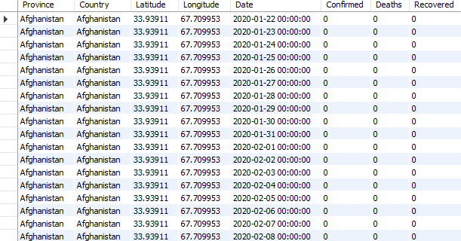
DATASET OVERVIEW

Slide 7
DATA EXPLORATION USING SQL

Slide 8
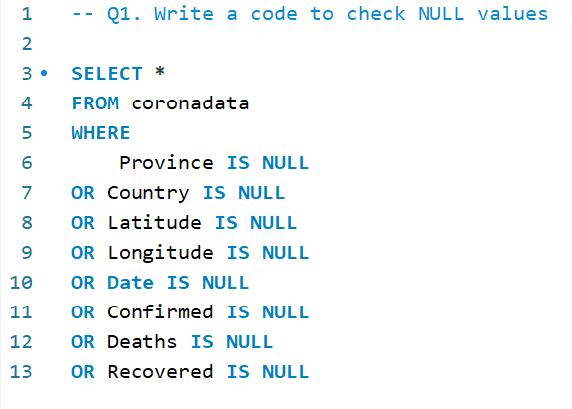

Check NULL Values
NO NULL VALUES PRESENT

Slide 9
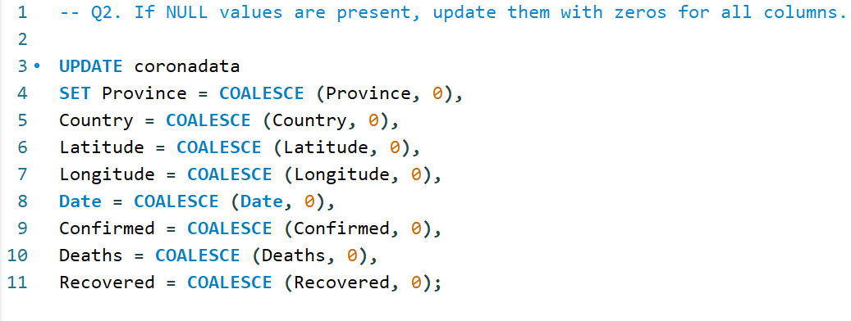
If NULL values are Present

Slide 10
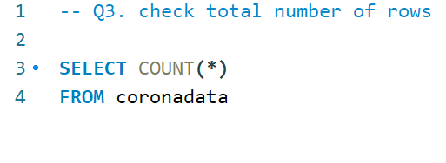

Total Number Of Rows
TOTAL
36290

Slide 11
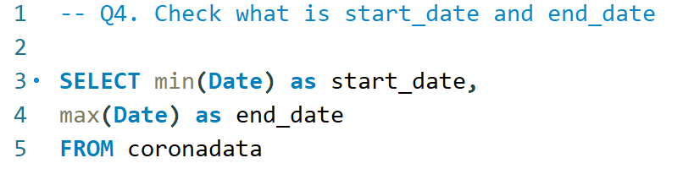
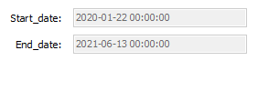
Start Date And End Date
START DATE – 22/01/2020
END DATE – 13/06/2021

Slide 12
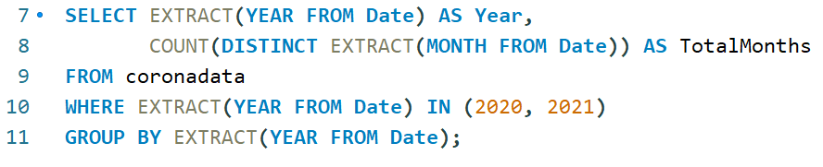

Total Number Of Month
TOTAL MONTHS – 18 MONTHS

Slide 13
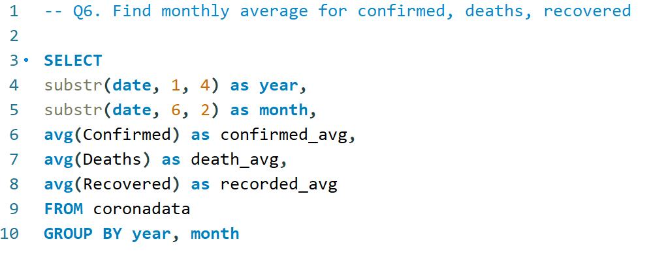
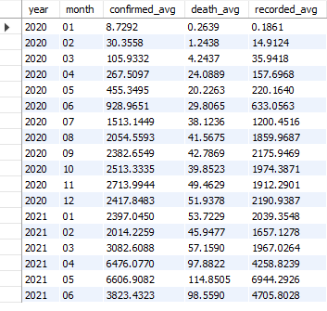
Monthly Average

Slide 14
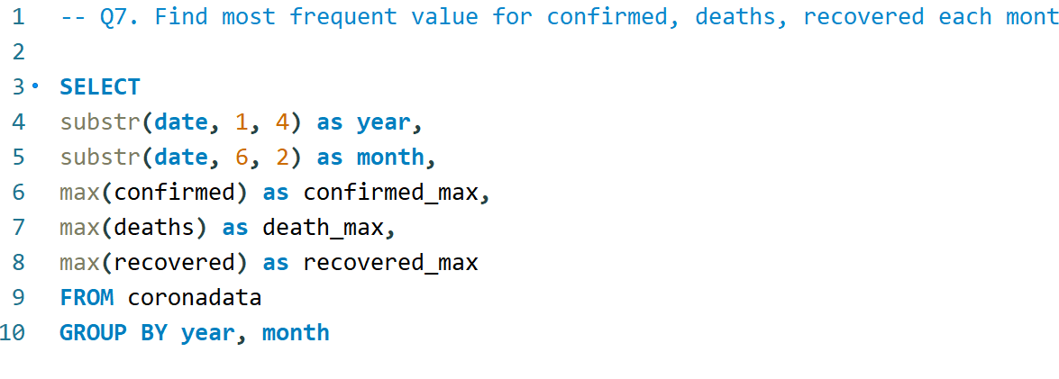
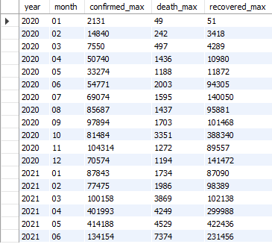
Most Frequent Value

Slide 15
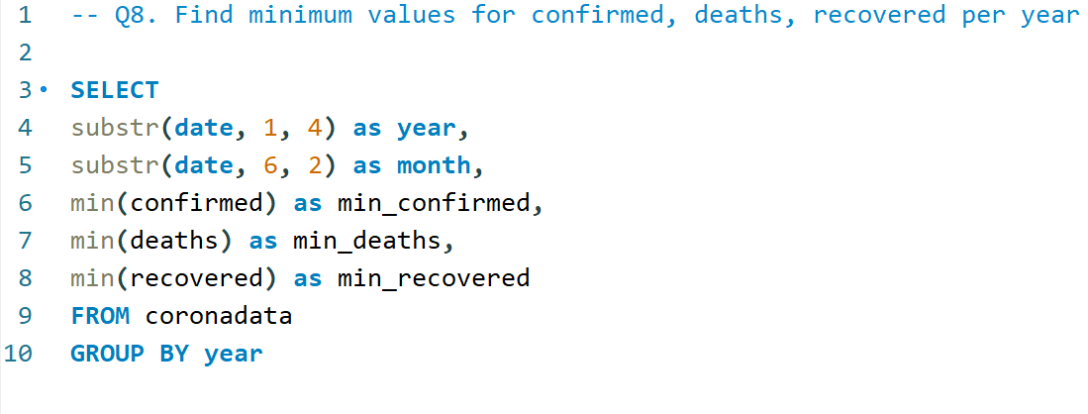

Minimum Values Per Year

Slide 16
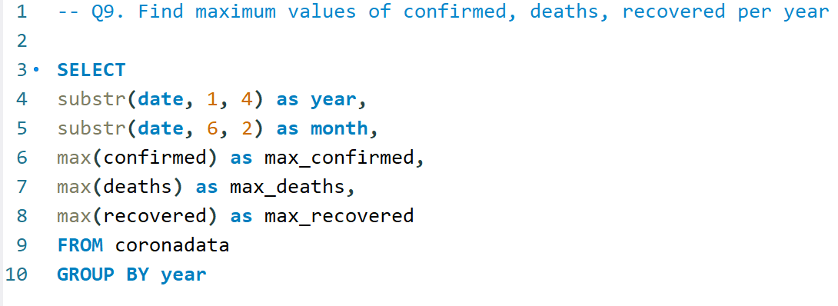

Maximum Values Per Year

Slide 17
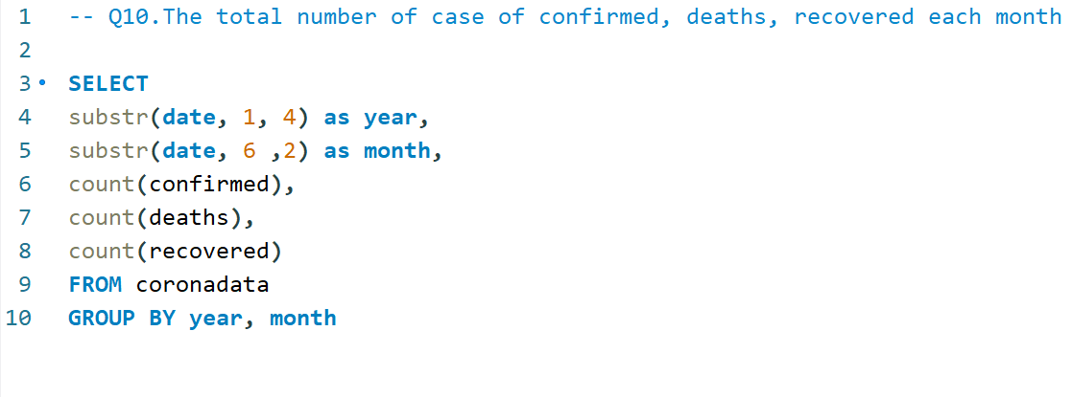
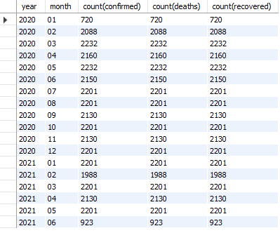
Total Number Of Cases In Each Month

Slide 18
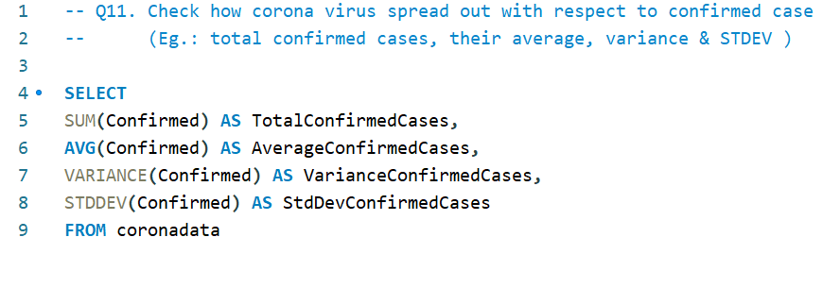
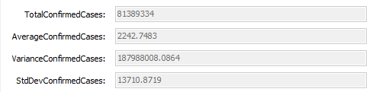
Virus Spread With Respect To Confirmed Cases

Slide 19
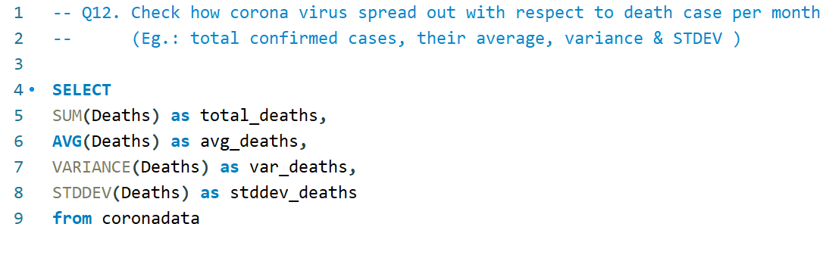
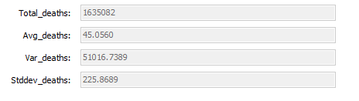
Virus Spread With Respect To Death Cases

Slide 20
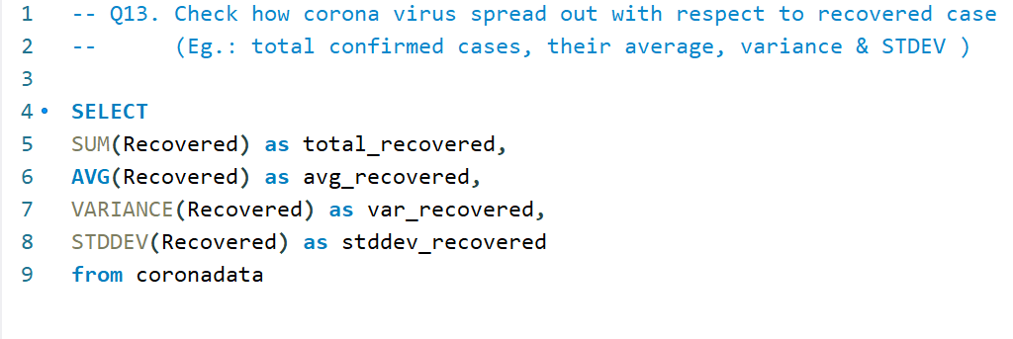
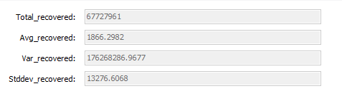
Virus Spread With Respect To Recovered Cases

Slide 21
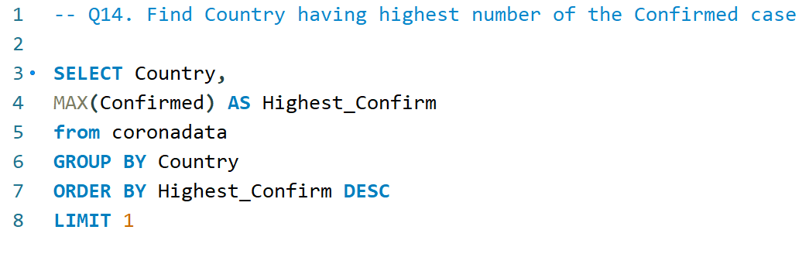
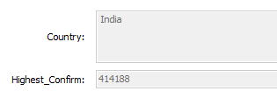
Country Having Highest Number Of Confirmed Case
INDIA

Slide 22
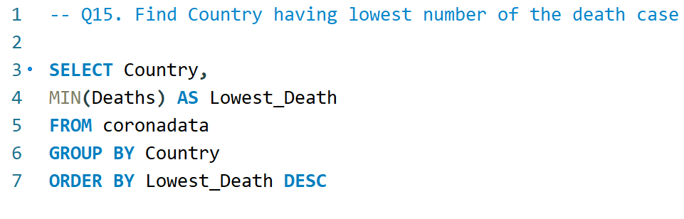
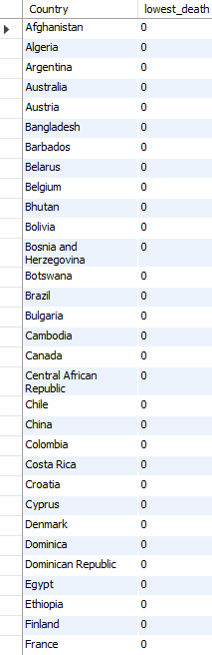
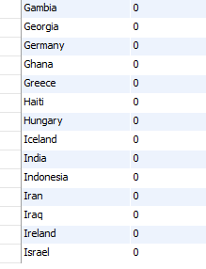
Country Having Lowest Number Of Death Case

Slide 23
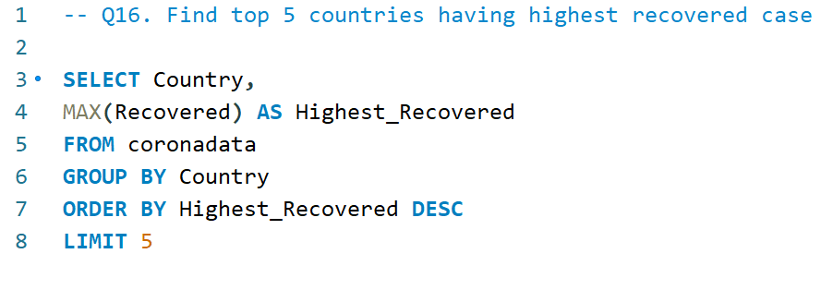
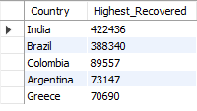
Top 5 Countries Having Highest Recovered Case
INDIA
BRAZIL
COLOMBIA
ARGENTINA
GREECE

Slide 24
THANK YOU

